Slide 1
CQ method guidelines
The process
is guided by reiteration, improvement of questions and being critical towards the answers.
The Storyboard design
Layer 1: Experiences and behaviours
Find or combine pictures reflecting you feelings when you observe, be creative!
Layer 2: Psychological
Why do people behave like this, what are the reasons, go back to the Developers.
Layer 3: History
Find pictures in telling the story what people went through.
Review
Reason back and continue to ask questions to move up from level 3 , to 2 to level 1 again to test your hypothesis, and down and up.

Slide 2
Culture definition & developers
Culture definition
A pattern of norms and values shared by a group,
conveyed to the next generation as being right.
Cultural developers
Geography
Climate
Technology
Population size
Diseases
Language
Philosophy
Notes:
https://thehypertextual.com/2013/01/17/edgar-schein-organizational-culture-and-leadership/al.com/2013/01/17/edgar-schein-organizational-culture-and-leadership/

Slide 3
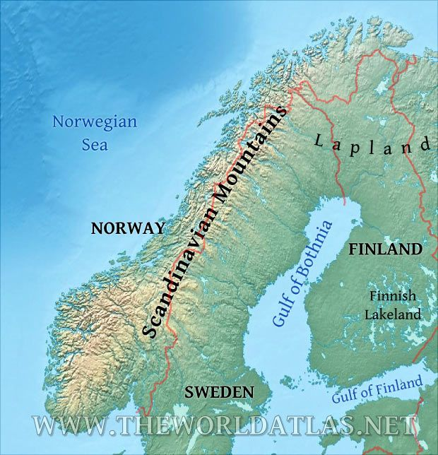
Look at the geographical situation of a country
Note:
various cultures can exist within the national borders of a country

Slide 4
The CQ method
Main area Society
Note
The CQ method is used for three main areas; personal relations, economy & society.

Slide 5
Cultural effects on:

Slide 6
The story board creation
Experiences &
observations
Behaviour
Historic
Events

Slide 7
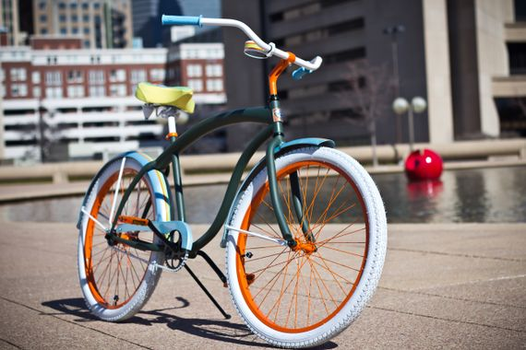
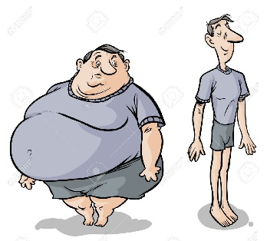
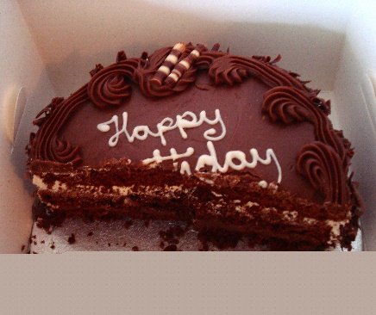
Observations & Experiences
observation
Experience
Experience
Observation
Experience
Observation

Slide 8
Behaviour
………….
…………
……………..
……….
Social interaction
(What do I observe)
Psychological aspects
(Which psychological behaviour leads to this observation)
…………
……………
…………..
The core
(Can the psychological aspects be condensed till one or two words)
……………..

Slide 9
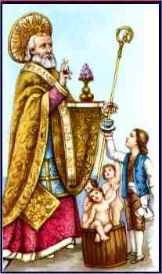
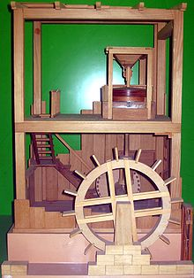
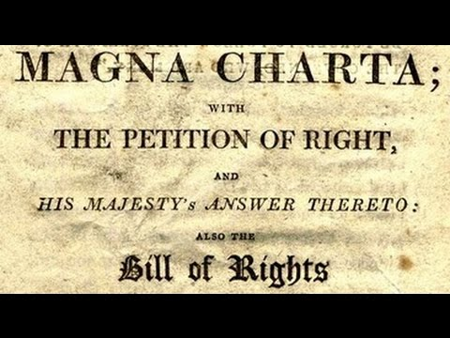
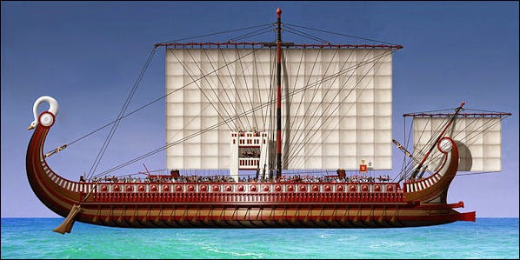
Historical events (using the Christian time scale)
1700 - 1800
Before 0
1400 – 1572
Note
1600 – 1900 Foreign rule
1347 – 1351
Note
Behaviour long ago
Behaviour today
Notes:
Research example Norway
750 – 1066 https://no.wikipedia.org/wiki/Vikingtiden
933 – 1028 https://no.wikipedia.org/wiki/Kristningen_av_Norge
1347 – 1351 https://no.wikipedia.org/wiki/Svartedauden
- North Sea book Michael Pye: Denmark/Sweden recovery took 100 years, Norway’s recovery took 400 years.
- Oslo var det området i Norge som ble hardest rammet av svartedauden. Deretter fulgte 1400- og 1500-årene med ytterligere nedgang, befolkningsmessig og økonomisk. Reformasjonen gjorde at Oslo også tapte kirken som en betydelig arbeidsplass.
1380 -1814 https://no.wikipedia.org/wiki/Danmark-Norge
1814 – 1907 hhttps://no.wikipedia.org/wiki/Unionen_mellom_Sverige_og_Norge
1969: https://no.wikipedia.org/wiki/Petroleumsvirksomhet_i_Norge

Slide 10
Priceless that you dare to ask questions!

